Slide 1
從資料科學到 機器學習與人工智慧

Slide 2
前言

Slide 3
各種大量資料的分析問題
手寫識別程式怎麼做？
如何實現人臉識別系統？
如何過濾垃圾郵件？
電子商務網站上猜你喜歡的商品是什麼原理？如何實現？
電影網站如何去推薦符合用戶喜好的電影？
如何利用機器學習對消費者的特性進行細分，從而更好地服務各細分市場的消費者？
銀行如何去檢測用戶的信用卡可能被盜了？

Slide 4
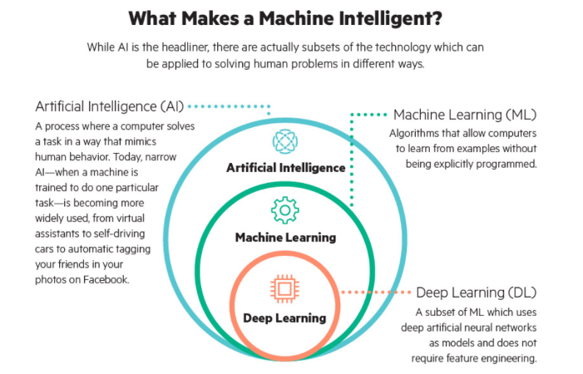
從工人(專家)智慧到人工(機器)智慧

Slide 5










學習套件
AI Deep Learning
Machine Learning
Data Science

Slide 6

學習平台
Google
學習平台

Slide 7
確認套件版本
import pandas as pd
print(“pandas version: %s” % pd.__version__)
import matplotlib
print("matplotlib version: %s" % matplotlib.__version__)
import numpy as np
print("numpy version: %s" % np.__version__)
import sklearn
print("scikit-learn version: %s" % sklearn.__version__)

Slide 8
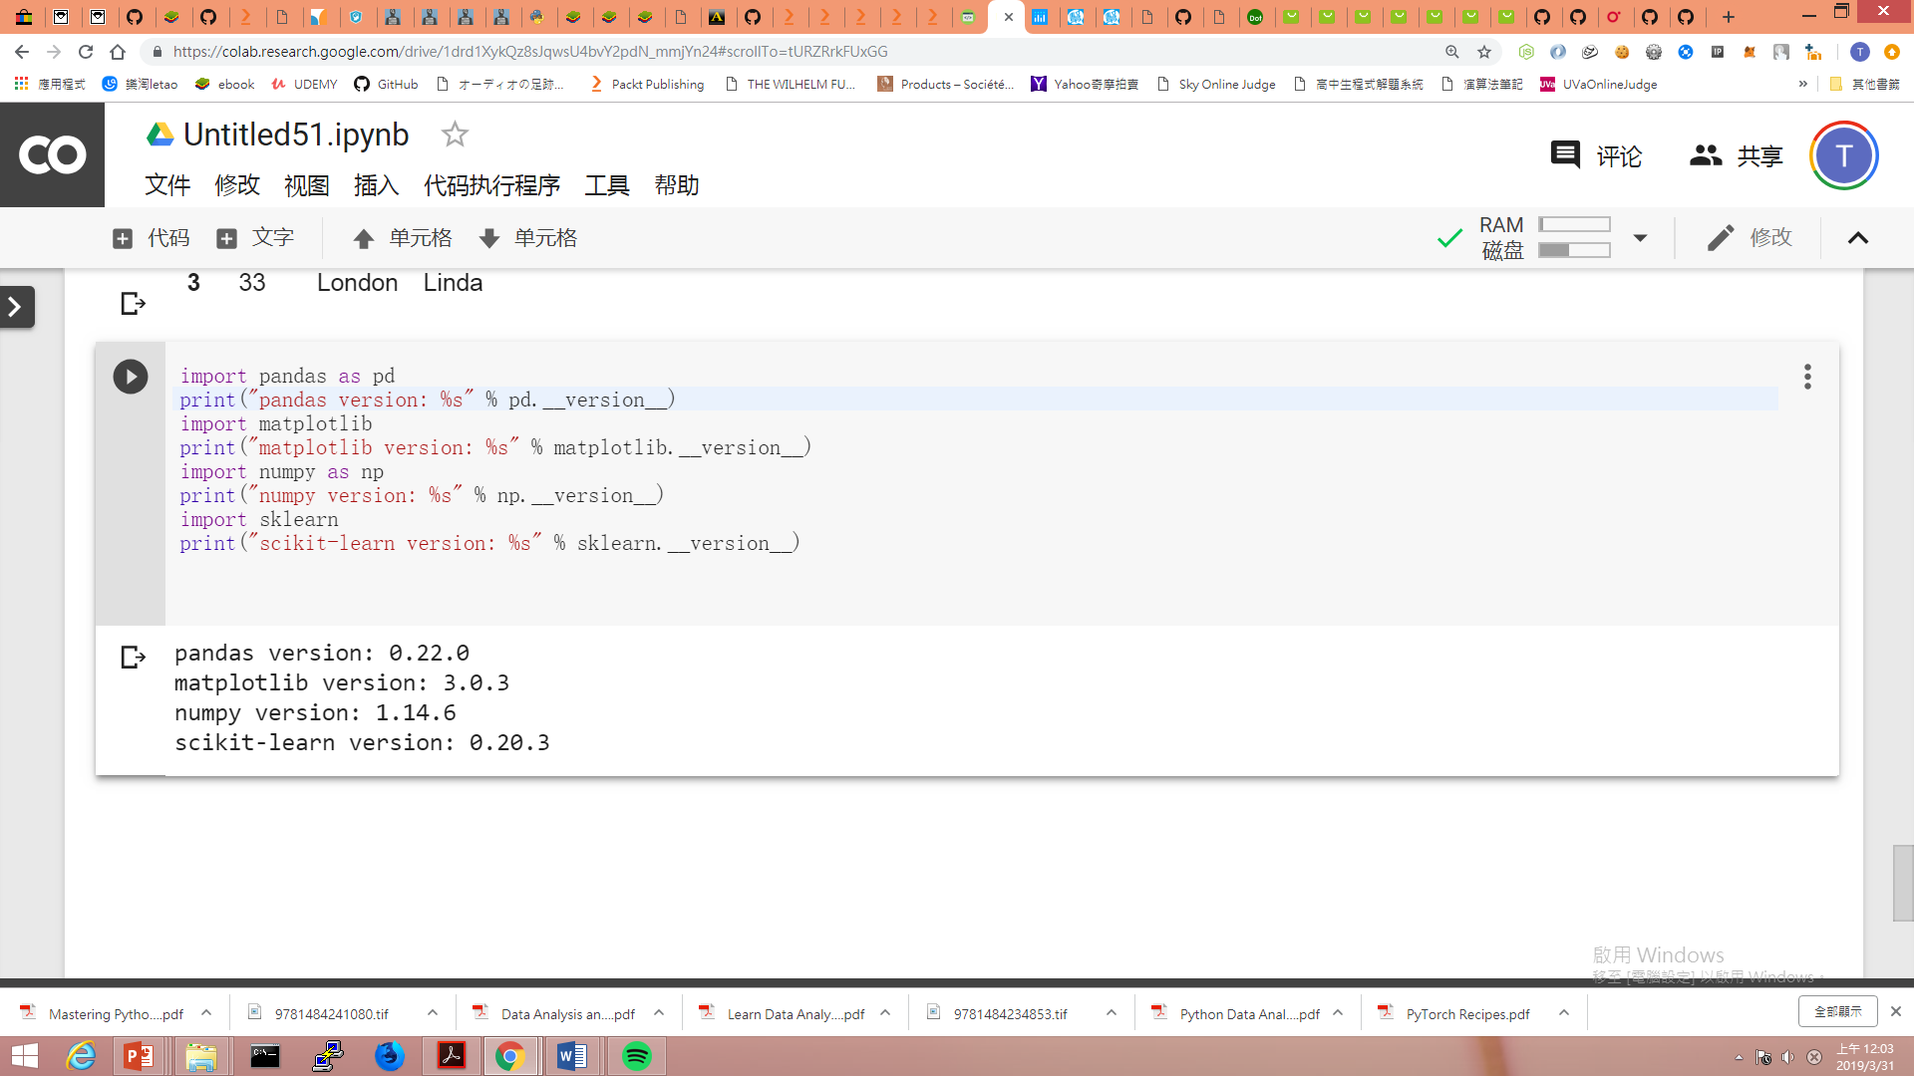

Slide 9
AI環境建置
Ubuntu 18.04 LTS 64-bit
安裝anaconda
安裝Tensorflow
安裝PYTORCH
安裝open AI gym

Slide 10

Data Science 資料科學

Slide 11
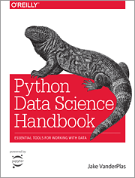
Python Data Science Handboo
Chapter 2 Introduction to NumPy
Chapter 3 Data Manipulation with Pandas
Chapter 4 Visualization with Matplotlib
Chapter 5 Machine Learning
https://jakevdp.github.io/PythonDataScienceHandbook/
https://github.com/jakevdp/PythonDataScienceHandbook

Slide 12
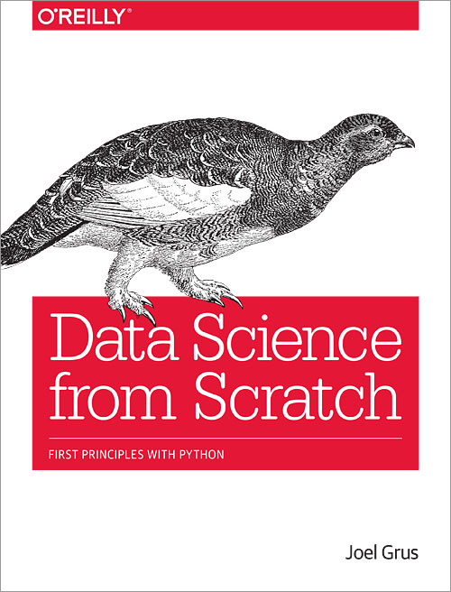
第1章 簡介 第2章 Python速成班 第3章 數據視覺化 第4章 線性代數 第5章 統計學 第6章 機率 第7章 假設與推論 第8章 梯度遞減 第9章 取得數據資料 第10章 處理數據資料
第11章 機器學習 第12章 k最近鄰 第13章 單純貝氏 第14章 簡單線性迴歸 第15章 多元迴歸 第16章 邏輯迴歸 第17章 決策樹 第18章 神經網路 第19章 集群 第20章 自然語言處理 第21章 網路分析 第22章 推薦系統 第23章 資料庫與SQL 第24章 MapReduce 第25章 勇往直前，資料科學做就對了
http://joelgrus.com/2015/04/26/data-science-from-scratch-first-principles-with-python/
https://github.com/joelgrus/data-science-from-scratch

Slide 13
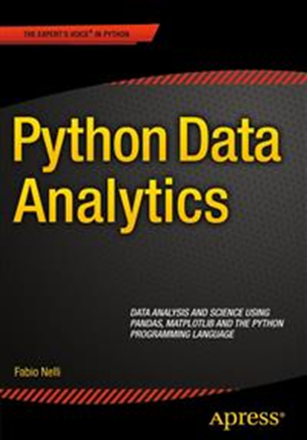
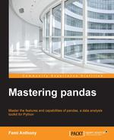
https://github.com/Apress/python-data-analytics
https://github.com/femibyte/mastering_pandas

Slide 14
Python 資料分析
NUMPY套件

Slide 15
NUMPY ndarray
N-Dimensional Arrays

Slide 16
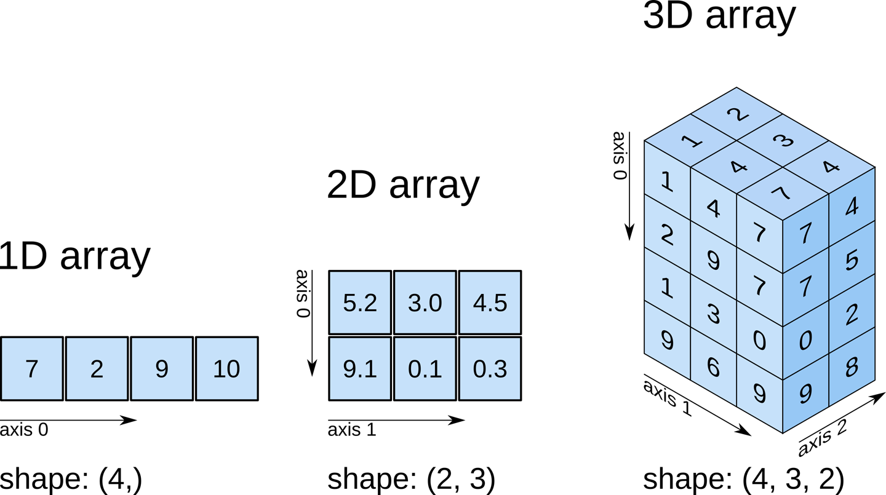
NumPy N-Dimensional Arrays
ndarray, or just array

Slide 17
建立array(陣列)
方法 | 範例
使用Python內建的array-like資料結構轉化得到 | x = np.array([[1,2.0],[0,0],(1+1j,3.)])
使用numpy提供的創建函數直接生成 | np.zeros((2, 3)) np.arange(2, 3, 0.1) # start, end, step np.linspace(1., 4., 6) # start, end, num np.indices((3, 3))
使用genfromtxt()方法生成 | ndtype=[('a',int), ('b', float), ('c', int)] names = ["A", "B", "C"] np.genfromtxt("file_name.txt", delimiter=",", names=names, dtype=ndtype, autostrip=True, comments="#", skip_header=3, skip_footer=5, usecols=(0, -1))
https://danzhuibing.github.io/py_numpy_ndarray.html

Slide 18
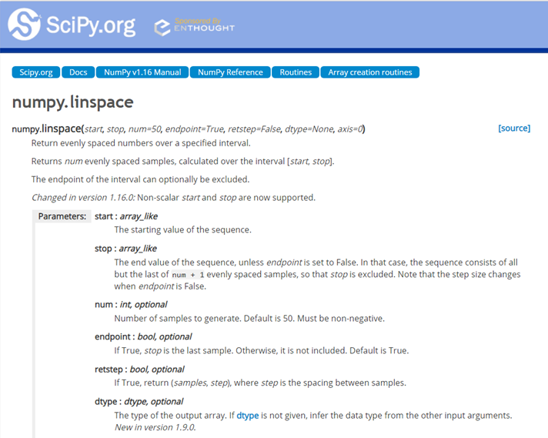
numpy.linspace
https://docs.scipy.org/doc/numpy/reference/generated/numpy.linspace.html
>>> np.linspace(2.0, 3.0, num=5)
array([ 2. , 2.25, 2.5 , 2.75, 3. ])
>>> np.linspace(2.0, 3.0, num=5, endpoint=False)
array([ 2. , 2.2, 2.4, 2.6, 2.8])
>>> np.linspace(2.0, 3.0, num=5, retstep=True)
(array([ 2. , 2.25, 2.5 , 2.75, 3. ]), 0.25)

Slide 19
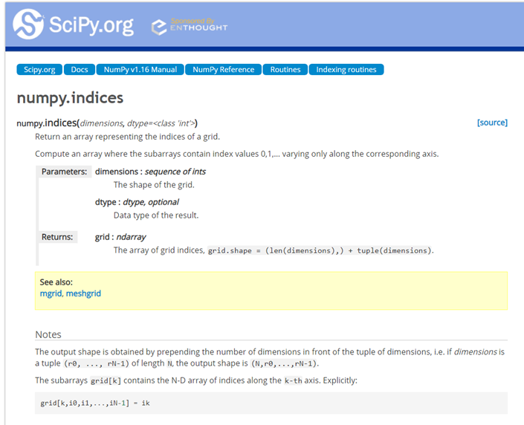
numpy.indices

Slide 20
ar2=np.array([[0,3,5],[2,8,7]]) # 2D array
Shape of the array
ar2.shape
Number of dimensions
ar2.ndim

Slide 21
Array shape manipulation
::reshape()
x = np.arange(4)
x2 = x.reshape(4,1)
numpy.reshape
https://docs.scipy.org/doc/numpy-1.13.0/reference/generated/numpy.reshape.html
https://ithelp.ithome.com.tw/articles/10195434
https://ithelp.ithome.com.tw/articles/10195830

Slide 22
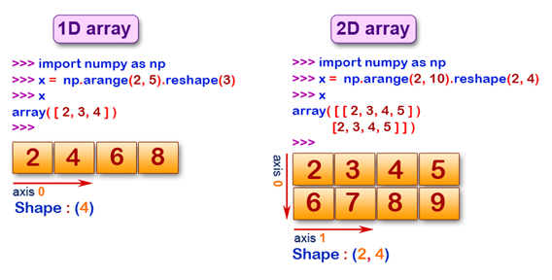
import numpy as np
a=np.array([[0,1],[2,3]])
a.reshape(1,4)
a.reshape(4,1)

Slide 23
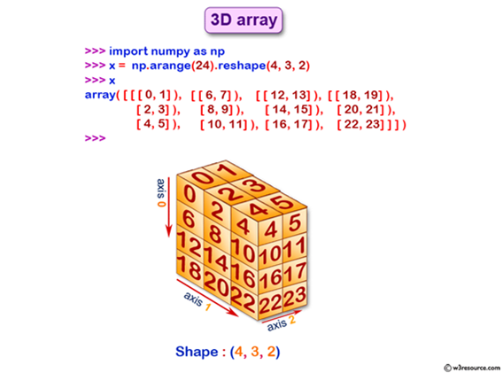
np.arange(24).reshape(3,4,2)
np.arange(24).reshape(4,3,2)

Slide 24
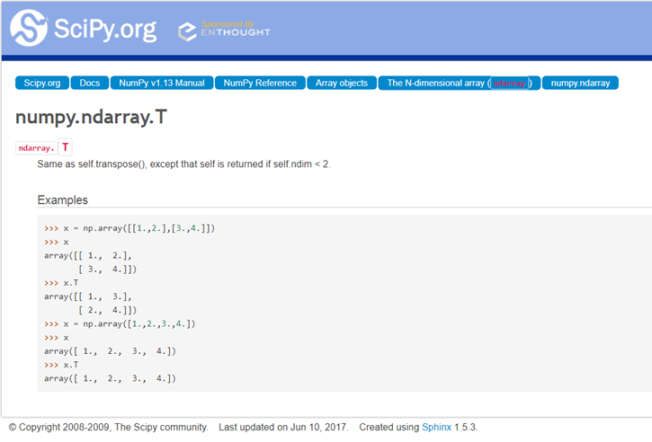
numpy.ndarray.T
import numpy as np
a=np.array([[0,1],[2,3]])
a.reshape(1,4)
a.reshape(4,1)

Slide 25
Array shape manipulation Flattening a multi-dimensional array
ar=np.array([np.arange(1,6),np.arange(10,15)]);
ar
ar.ravel()
ar.T.ravel()

Slide 26
為什麼你用不好Numpy的random函數？
https://www.jianshu.com/p/214798dd8f93

Slide 27
numpy.random.rand()
numpy.random.rand(d0,d1,...,dn)
rand函數根據給定維度生成[0,1)之間的資料，包含0，不包含1
dn表格每個維度
返回值為指定維度的array
np.random.rand(4,2)
array([[ 0.02173903, 0.44376568],
[ 0.25309942, 0.85259262],
[ 0.56465709, 0.95135013],
[ 0.14145746, 0.55389458]])

Slide 28
numpy.random.rand()
# shape: 4*3*2
np.random.rand(4,2)
np.random.rand(4,3,2)
array([[[ 0.08256277, 0.11408276],
[ 0.11182496, 0.51452019],
[ 0.09731856, 0.18279204]],
[[ 0.74637005, 0.76065562],
[ 0.32060311, 0.69410458],
[ 0.28890543, 0.68532579]],
[[ 0.72110169, 0.52517524],
[ 0.32876607, 0.66632414],
[ 0.45762399, 0.49176764]],
[[ 0.73886671, 0.81877121],
[ 0.03984658, 0.99454548],
[ 0.18205926, 0.99637823]]])
array([[ 0.02173903, 0.44376568],
[ 0.25309942, 0.85259262],
[ 0.56465709, 0.95135013],
[ 0.14145746, 0.55389458]])

Slide 29
numpy.random.randint()
numpy.random.randint(low, high=None, size=None, dtype='l')
返回隨機整數，範圍區間為[low,high），包含low，不包含high參數
low為最小值，high為最大值，size為陣列維度大小，dtype為資料類型，預設的資料類型是np.int
high沒有填寫時，預設生成亂數的範圍是[0，low)
np.random.randint(1,size=5) # 返回[0,1)之間的整數，所以只有0
# array([0, 0, 0, 0, 0])
np.random.randint(1,5) # 返回1个[1,5)时间的随机整数
# 4
np.random.randint(-5,5,size=(2,2))
# array([[ 2, -1],
[ 2, 0]])

Slide 30
numpy.random.seed()
作用：使得亂數據可預測。
當我們設置相同的seed，每次生成的亂數相同。
如果不設置seed，則每次會生成不同的亂數
np.random.seed(0)
np.random.rand(5)
array([ 0.5488135 , 0.71518937, 0.60276338, 0.54488318, 0.4236548 ])
np.random.seed(1676)
np.random.rand(5)
array([ 0.39983389, 0.29426895, 0.89541728, 0.71807369, 0.3531823 ])
np.random.seed(1676)
np.random.rand(5)

Slide 31
建立array(陣列)
import numpy as np
np.random.seed(0)
x1 = np.random.randint(10, size=6)
x2 = np.random.randint(10, size=(3, 4))
x3 = np.random.randint(10, size=(3, 4, 5))
# seed for reproducibility
One-dimensional array
Two-dimensional array
Three-dimensional array

Slide 32
x1 = np.random.randint(10, size=6)
array([5, 0, 3, 3, 7, 9])
x2 = np.random.randint(10, size=(3, 4))
array([[3, 5, 2, 4],
[7, 6, 8, 8],
[1, 6, 7, 7]])

Slide 33
x3 = np.random.randint(10, size=(3, 4, 5))
array([[[8, 1, 5, 9, 8],
[9, 4, 3, 0, 3],
[5, 0, 2, 3, 8],
[1, 3, 3, 3, 7]],
[[0, 1, 9, 9, 0],
[4, 7, 3, 2, 7],
[2, 0, 0, 4, 5],
[5, 6, 8, 4, 1]],
[[4, 9, 8, 1, 1],
[7, 9, 9, 3, 6],
[7, 2, 0, 3, 5],
[9, 4, 4, 6, 4]]])

Slide 34
create identity matrix
array([[ 1., 0., 0.],
[ 0., 1., 0.],
[ 0., 0., 1.]])

Slide 35
create identity matrix
array([[ 1., 0., 0.],
[ 0., 1., 0.],
[ 0., 0., 1.]])
ar9 = np.eye(3);
ar9

Slide 36
Create diagonal array
array([[2, 0, 0, 0],
[0, 1, 0, 0],
[0, 0, 4, 0],
[0, 0, 0, 6]])

Slide 37
Create diagonal array
array([[2, 0, 0, 0],
[0, 1, 0, 0],
[0, 0, 4, 0],
[0, 0, 0, 6]])
ar10=np.diag((2,1,4,6));
ar10

Slide 38
import numpy as np
np.array([range(i, i + 3) for i in [2, 4, 6]])

Slide 39
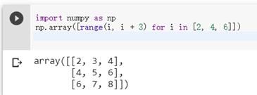
import numpy as np
np.array([range(i, i + 3) for i in [2, 4, 6]])

Slide 40
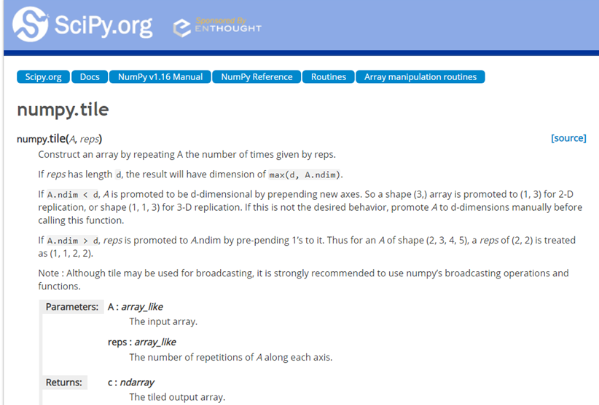
https://docs.scipy.org/doc/numpy/reference/generated/numpy.tile.html
>>> a = np.array([0, 1, 2])
>>> np.tile(a, 2)
array([0, 1, 2, 0, 1, 2])
>>> np.tile(a, (2, 2))
array([[0, 1, 2, 0, 1, 2],
[0, 1, 2, 0, 1, 2]])
>>> np.tile(a, (2, 1, 2))
array([[[0, 1, 2, 0, 1, 2]],
[[0, 1, 2, 0, 1, 2]]])

Slide 41
作業:下列答案為何?
np.tile(np.array([[1,2],[6,7]]),3)
np.tile(np.array([[1,2],[6,7]]),(2,2))

Slide 42
np.tile(np.array([[1,2],[6,7]]),3)
array([[1, 2, 1, 2, 1, 2],
[6, 7, 6, 7, 6, 7]])
np.tile(np.array([[1,2],[6,7]]),(2,2))
array([[1, 2, 1, 2],
[6, 7, 6, 7],
[1, 2, 1, 2],
[6, 7, 6, 7]])

Slide 43
Structured Array
numpy只支援單一資料類型
定義結構化陣列有四種方式：1) string, 2) tuple, 3) list, or 4) dictionary。
推薦使用後兩種方式。
import numpy as np
# list方式
persontype = [('name', np.str_), ('age', np.int16), ('weight', np.float32)]
# dict方式：需要指定的键值有names和formats
persontype = np.dtype({
'names': ['name', 'age', 'weight'],
'formats': [np.str_, np.int16, np.float32]
})
a = np.array([("Zhang", 32, 75.5), ("Wang", 24, 65.2)], dtype=persontype)
# list方式：a list of tuples. Each tuple has 2 or 3 elements specifying: 1) The name of the field (‘’ is permitted), 2) the type of the field, and 3) the shape (optional)

Slide 44
NUMPY ndarray 運算

Slide 45
Array Indexing: Accessing Single Elements
Import numpy as np
x1 = np.random.randint(10, size=6)
x1
array([5, 0, 3, 3, 7, 9])
x1[0]
x1[-2]
x1[-1]

Slide 46
Array Indexing: Accessing Single Elements
Import numpy as np
x2 = np.random.randint(10, size=(3, 4))
x2
array([[3, 5, 2, 4],
[7, 6, 8, 8],
[1, 6, 7, 7]])
x2[2, 0]
print(x2[0, :])
x2[0, 2]
print(x2[0])
x2[2, -1]

Slide 47
Reverse array
ar=np.arange(5);
ar[::-1]

Slide 48
ar = np.array([[2,3,4],[9,8,7],[11,12,13]]);
ar
ar[2,:] =?
ar[:,1] =?

Slide 49
Array slicing
ar=2*np.arange(6);
ar
ar[1:5:2]=?
ar[1:6:2]=?
ar[:4]=?
ar[4:] =?
ar[::3]=?
ar[:3]=1;
ar
ar[2:]=np.ones(4);
ar

Slide 50
NumPy faster for this than Python
ar=np.arange(1000)
%timeit ar**3
ar=range(1000)
%timeit [ar[i]**3 for i in ar]

Slide 51
Array multiplication is element wise
ar=np.array([[1,1],[1,1]]);
ar2=np.array([[2,2],[2,2]]);
ar*ar2
ar.dot(ar2)

Slide 52
Reduction Operations
ar=np.arange(1,5)
ar.prod()
ar=np.array([np.arange(1,6),np.arange(1,6)]);
ar
np.prod(ar,axis=0)=?
np.prod(ar,axis=1)=?

Slide 53
Reduction Operations
ar=np.array([[2,3,4],[5,6,7],[8,9,10]]);
ar.sum()
ar.mean()
np.median(ar)

Slide 54
Numpy檔案輸入與輸出
https://ithelp.ithome.com.tw/articles/10196167

Slide 55
使用加快速度運算的 Universal Functions

Slide 56
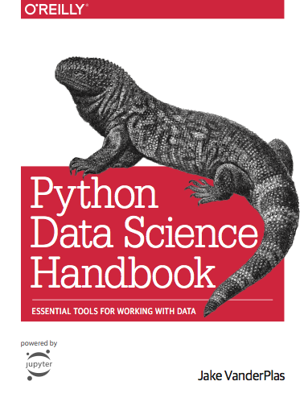
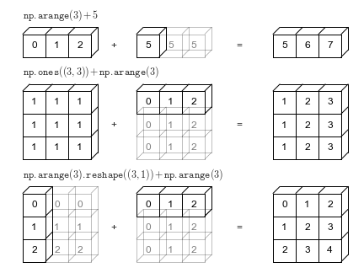
Broadcasting
https://jakevdp.github.io/PythonDataScienceHandbook/02.05-computation-on-arrays-broadcasting.html

Slide 57
Rules of Broadcasting
Rule 1: If the two arrays differ in their number of dimensions, the shape of the one with fewer dimensions is padded with ones on its leading (left) side.
Rule 2: If the shape of the two arrays does not match in any dimension, the array with shape equal to 1 in that dimension is stretched to match the other shape.
Rule 3: If in any dimension the sizes disagree and neither is equal to 1, an error is raised.

Slide 58
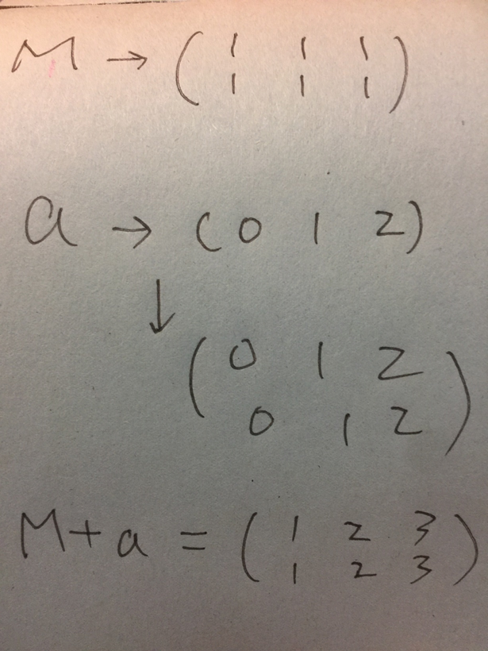
Broadcasting example 1
M = np.ones((2, 3))
a = np.arange(3)
M + a

Slide 59
Broadcasting example 1
M = np.ones((2, 3))
a = np.arange(3)
M + a

Slide 60
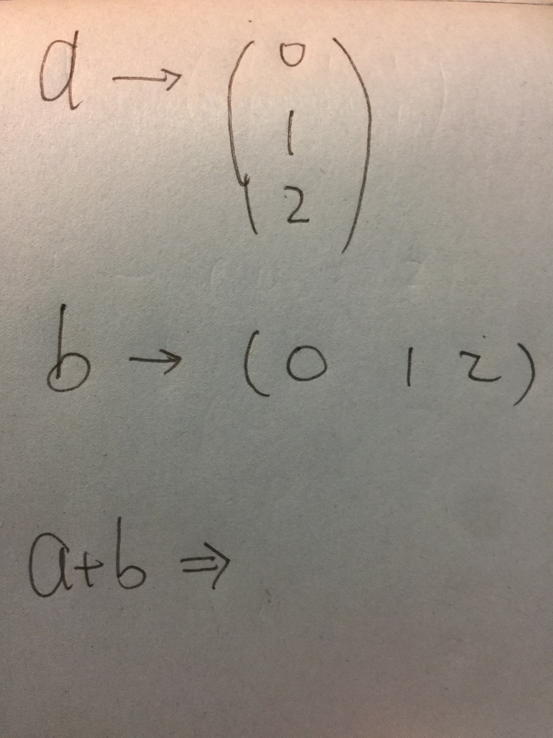
Broadcasting example 2
a = np.arange(3).reshape((3, 1))
b = np.arange(3)
a + b

Slide 61
Adding a dimension
ar=np.array([14,15,16]); ar.shape
ar
(3,)
array([14, 15, 16])
ar=ar[:, np.newaxis]; ar.shape
ar
(3, 1)
array([[14],
[15],
[16]])
https://github.com/femibyte/mastering_pandas/blob/master/MasteringPandas-chap3_DataStructures.ipynb

Slide 62
Array sorting
ar=np.array([[3,2],[10,-1]])
ar
ar.sort(axis=1)
ar
ar=np.array([[3,2],[10,-1]])
ar
ar.sort(axis=0)
ar
https://github.com/femibyte/mastering_pandas/blob/master/MasteringPandas-chap3_DataStructures.ipynb

Slide 63
%matplotlib inline
import numpy as np
import matplotlib.pyplot as plt
# Generate a sequence of integers
x = np.arange(20)
# create a second array using sinus
y = np.sin(x)
# The plot function makes a line chart of one array against another
plt.plot(x, y, marker="x")

Slide 64
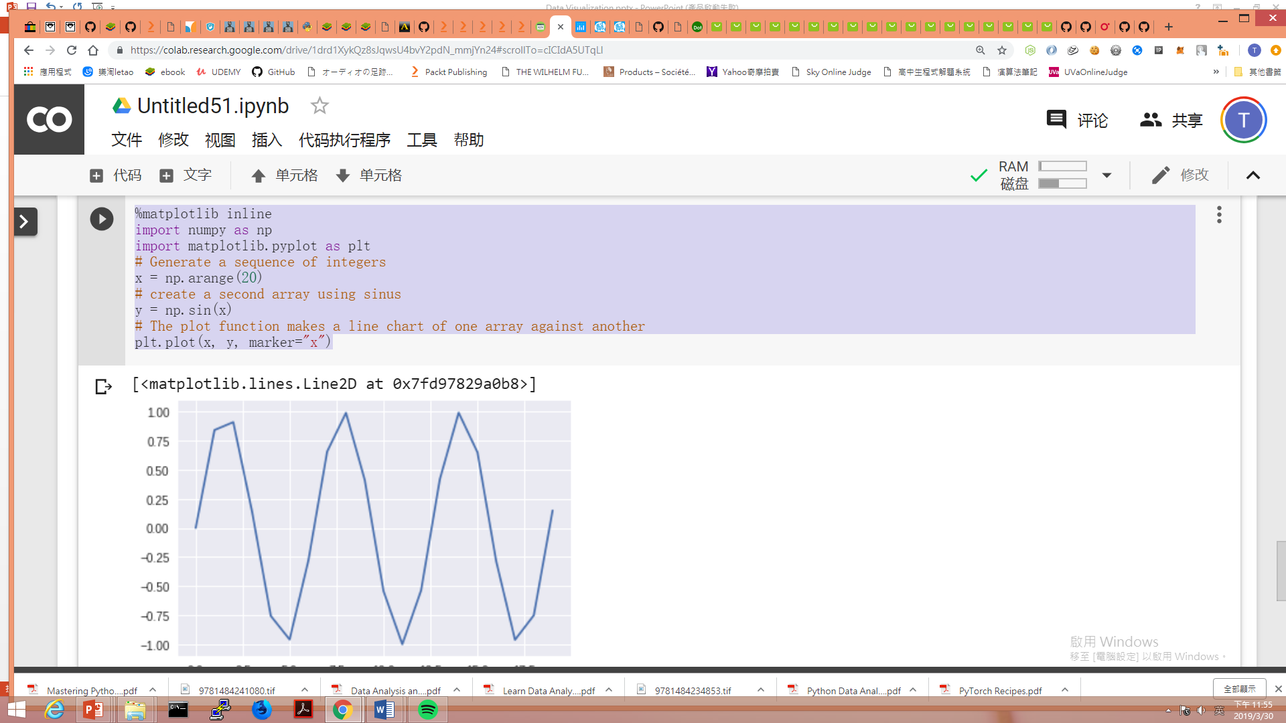

Slide 65
NUMPY實作練習:
類神經網路起手式:
感知器

Slide 66
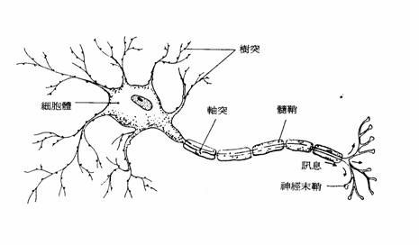
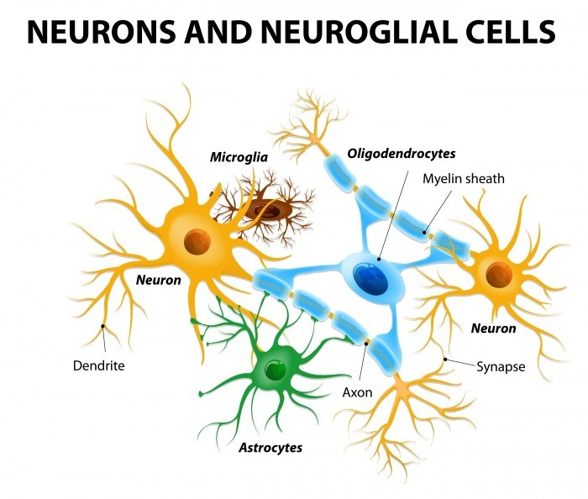
神經網路
生物神經系統的結構，神經元(Neuron)之間互相連結，由外部神經元接收信號，再層層傳導至其他神經元，最後作出反應的過程
neural network
https://ithelp.ithome.com.tw/articles/10191528

Slide 67
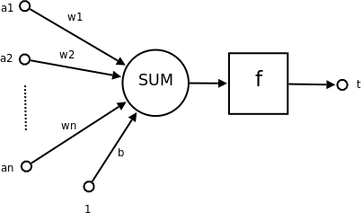
模型化➔類神經網路
Artificial neural network
感知機 perceptron
Weight(權重)
激活函數
Activation function
Bias(偏權值)

Slide 68
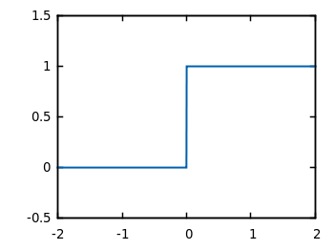
激活函數:Activation function Step Function

Slide 69
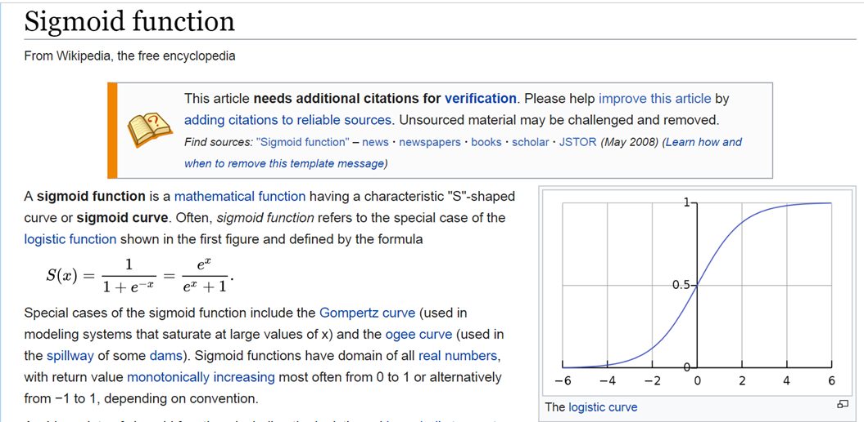
激活函數:Activation function Sigmoid function
https://en.wikipedia.org/wiki/Sigmoid_function

Slide 70
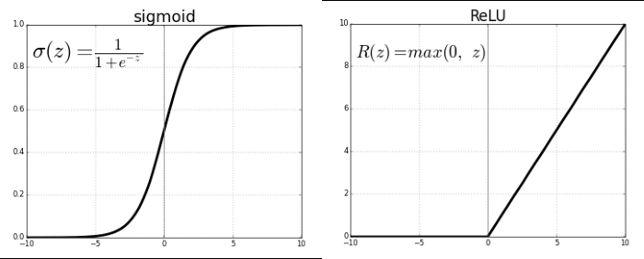

Slide 71
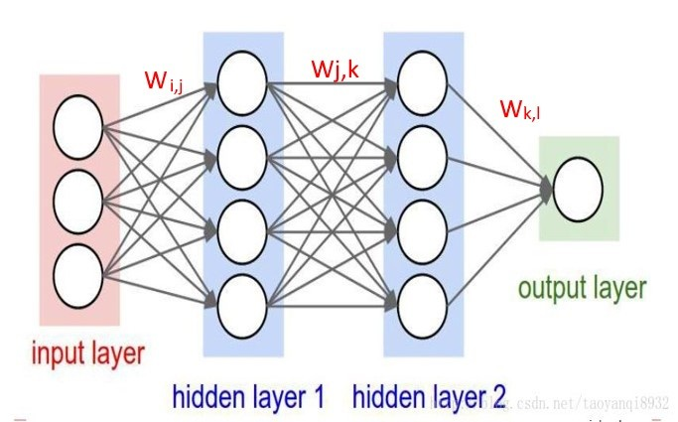
多層感知機 Multilayer perceptron, MLP

Slide 72
輸入 |  |  |  |  | 輸出
A | B | A and B | A or B | A NAND B | A XOR B
0 | 0 |  |  |  | 0
0 | 1 |  |  |  | 1
1 | 0 |  |  |  | 1
1 | 1 |  |  |  | 0

Slide 73
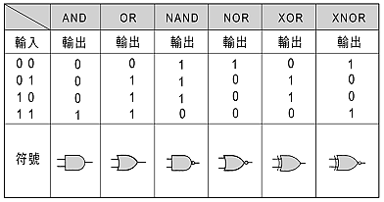
真值表[邏輯閘]

Slide 74
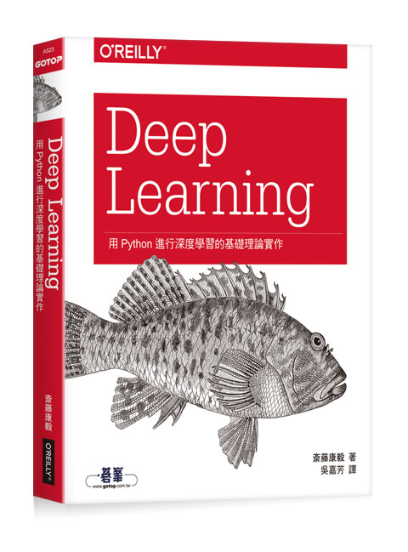
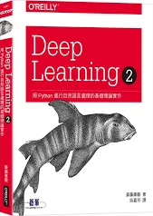

Slide 75
Deep Learning：用Python進行深度學習的基礎理論實作
作者： 斎藤康毅 譯者： 吳嘉芳
出版社：歐萊禮 出版日期：2017/08/17
第一章 Python入門
第二章 感知器
第三章 神經網路
第四章 神經網路的學習
第五章 誤差反向傳播法
第六章 與學習有關的技巧
第七章 卷積神經網路
第八章 深度學習
附錄A Softmax-with-Loss層的計算圖
參考文獻
https://github.com/oreilly-japan/deep-learning-from-scratch

Slide 76
第一章 複習類神經網路
第二章 自然語言與字詞的分散式表示
第三章 word2vec
第四章 word2vec的高速化
第五章 遞歸神經網路(RNN)
第六章 含閘門的RNN
第七章 使用RNN產生文章
第八章 Attention
附錄A sigmoid函數與tanh函數的微分
附錄B 啟用WordNet
附錄C GRU
https://github.com/oreilly-japan/deep-learning-from-scratch-2

Slide 77
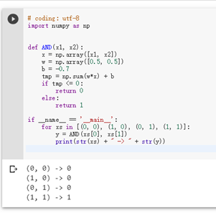
# coding: utf-8
import numpy as np
def AND(x1, x2):
x = np.array([x1, x2])
w = np.array([0.5, 0.5])
b = -0.7
tmp = np.sum(w*x) + b
if tmp <= 0:
return 0
else:
return 1
if __name__ == '__main__':
for xs in [(0, 0), (1, 0), (0, 1), (1, 1)]:
y = AND(xs[0], xs[1])
print(str(xs) + " -> " + str(y))
https://github.com/MyDearGreatTeacher/AI4high/blob/master/LogicalGate.ipynb

Slide 78
第二章 感知器
# coding: utf-8
import numpy as np
def AND(x1, x2):
x = np.array([x1, x2])
w = np.array([0.5, 0.5])
b = -0.7
tmp = np.sum(w*x) + b
if tmp <= 0:
return 0
else:
return 1
if __name__ == '__main__':
for xs in [(0, 0), (1, 0), (0, 1), (1, 1)]:
y = AND(xs[0], xs[1])
print(str(xs) + " -> " + str(y))
# coding: utf-8
import numpy as np
def OR(x1, x2):
x = np.array([x1, x2])
w = np.array([0.5, 0.5])
b = -0.2
tmp = np.sum(w*x) + b
if tmp <= 0:
return 0
else:
return 1
if __name__ == '__main__':
for xs in [(0, 0), (1, 0), (0, 1), (1, 1)]:
y = OR(xs[0], xs[1])
print(str(xs) + " -> " + str(y))

Slide 79
第二章 感知器
# coding: utf-8
import numpy as np
def AND(x1, x2):
x = np.array([x1, x2])
w = np.array([0.5, 0.5])
b = -0.7
tmp = np.sum(w*x) + b
if tmp <= 0:
return 0
else:
return 1
if __name__ == '__main__':
for xs in [(0, 0), (1, 0), (0, 1), (1, 1)]:
y = AND(xs[0], xs[1])
print(str(xs) + " -> " + str(y))
# coding: utf-8
import numpy as np
def NAND(x1, x2):
x = np.array([x1, x2])
w = np.array([-0.5, -0.5])
b = 0.7
tmp = np.sum(w*x) + b
if tmp <= 0:
return 0
else:
return 1
if __name__ == '__main__':
for xs in [(0, 0), (1, 0), (0, 1), (1, 1)]:
y = NAND(xs[0], xs[1])
print(str(xs) + " -> " + str(y))

Slide 80
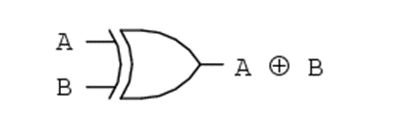
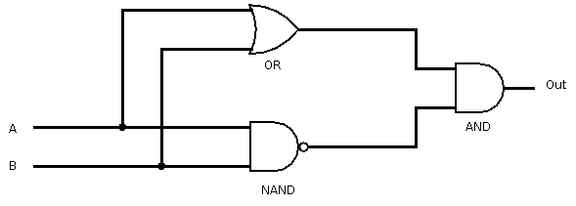
第二章 感知器
# coding: utf-8
from and_gate import AND
from or_gate import OR
from nand_gate import NAND
def XOR(x1, x2):
s1 = NAND(x1, x2)
s2 = OR(x1, x2)
y = AND(s1, s2)
return y
if __name__ == '__main__':
for xs in [(0, 0), (1, 0), (0, 1), (1, 1)]:
y = XOR(xs[0], xs[1])
print(str(xs) + " -> " + str(y))

Slide 81


Slide 82
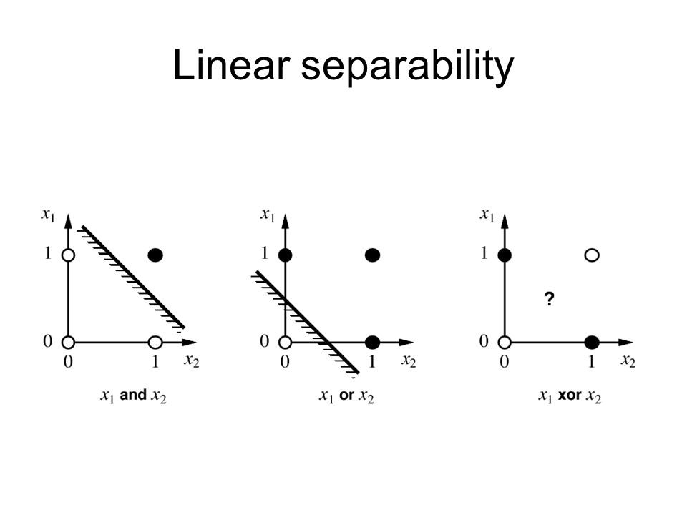

Slide 83
